Slide 1
TASK 12
State Pattern
26. May 2015
Team Green: MR, NM, RZ, SB, TS

Slide 2
Agenda
State-Dependent Features
Selected Feature
State Diagram
Code walkthrough
Pros & Cons

Slide 3
State-Dependent Features
Tracking of user actions
Calendar events/tasks and actions
Meeting Flow

Slide 4
Selected Feature
Meeting flow is an important feature of our application that leads a doctor
From creating/selecting patient
To Setting appointments/Medications and taking notes
Finishing the meeting with Prescription

Slide 5
State Diagram
Start Meeting
Create Patient
Select Patient
Make Notes
Prescription
Add Meeting

Slide 6
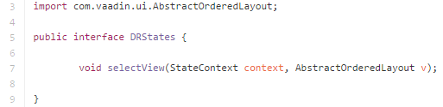
Code Walkthrough
Interface
Function to set Parent View and Current context

Slide 7
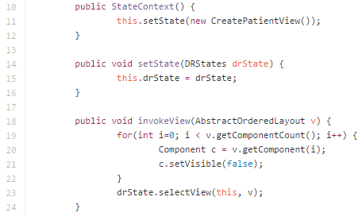
Code Walkthrough
State Context Class
Changes State
Manipulates the current context before the change

Slide 8

Code Walkthrough
Implementation
States are embedded into the Views
State change defined by
Button-click
Input validation

Slide 9
Pros & Cons
Pros
Easy control
Easy to change the flow
All data stored in session and saved to the DB in the end
Cons
Separate class for every state

Slide 10
Questions?

